Slide 1
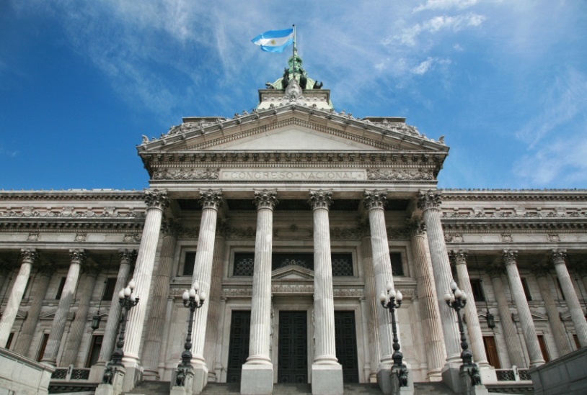
Introduction to Government
Government is the institution through which society makes and enforces its public policies. Government is also the legitimate use of force within territorial boundaries to control human behavior. Government is composed of the formal and informal institutions , people and processes used to create and conduct public policies.

Slide 2
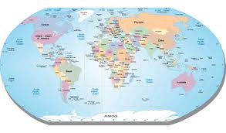
The “state” is the dominant political unit in the world.
A state is defined as a body of people living in a defined territory, organized politically (under a government) and having the power to make and enforce law without the consent of any higher authority.

Slide 3
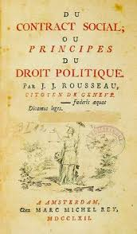
Characteristics of a state:
1. Population
2. Territory
3. Sovereignty (supreme and absolute power)
4. Government (politically organized)
Four theories of the origins of the state…
Evolutionary Theory
Force Theory
Divine Right Theory
Social Contract Theory

Slide 4
Classifications of government
Governments are classified according to:
The geographic distribution of power
The relationship between the executive and legislative branches
The number of people who participate

Slide 5
Geographic Distribution of Power
Unitary – centralized government, all power held by single agency.
Federal – division of powers between central and “local”
Confederate – alliance of independent states

Slide 6
Relationship of Legislative and Executive
Presidential – separation of powers (people elect the president
Parlimentary – legislative and executive branches must be the same party

Slide 7
Number of People Who Can Participate
Dictatorship (Totalitarian Regime)
Oligarchy
Direct Democracy
Representative Democracy

Slide 8
Basic concepts of democracy and purposes of government…
1. Fundamental worth of the individual
2. Equality of all persons (opportunity, before the law)
3. Majority Rule/Minority rights
4. Necessity of Compromise
5. Individual freedom

Slide 9
Do We Have a Democracy?
Majoritarian theory
Elitist theory
Pluralist theory
Bureaucratic theory

Slide 10
Enduring Questions
If citizens are fit to select political leaders, why may they be unfit to govern themselves without such leaders?
What is the difference between power, authority and legitimacy?
What is democracy, and why is democracy alone not sufficient to protect people?

Slide 11
Additional thoughts…
U.S. political culture and political socialization help create shared fundamental values including liberty (freedom), equality, private property and order. The dilemma of modern government is to balance freedom, order and equality.
The changing face of America – aging and ethnic changes, family structure and education…what will the impact be on politics?

Slide 12
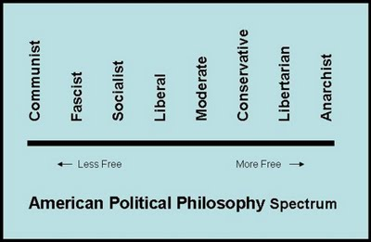
Political Spectrum

